Slide 1

Community Board
Final Presentation
Team 4:
Brittany
Brandon
George
Edgar

Slide 2
Functional requirements
The user will register an account and log in. If login is invalid, an error message will display.
Logged in users can create, update, and delete their announcements.
Users will be able to view and search announcements made.
If no announcements are found given the user’s criteria, a “Not Found” message will be displayed.
Users will be able to contact the person of the post via filling an email form. If the user is not logged in, the system will redirect them to the register page.
Anyone will be able to report inappropriate announcements and will notify administrators

Slide 3
Non-Functional requirements
Privacy protection (not sharing private information).
Quick response time when searching/loading posts.
Error messages/handling, no crashes of server.
Users must have an internet connection.

Slide 4
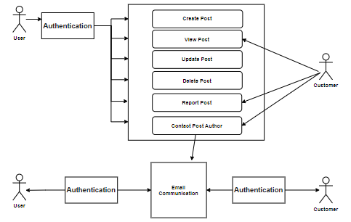
Use Case Diagram Considerations

Slide 5
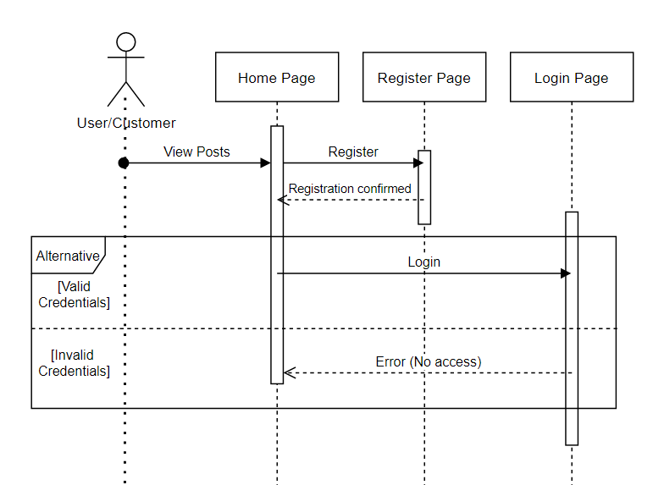
Home Page & Registration & Login

Slide 6
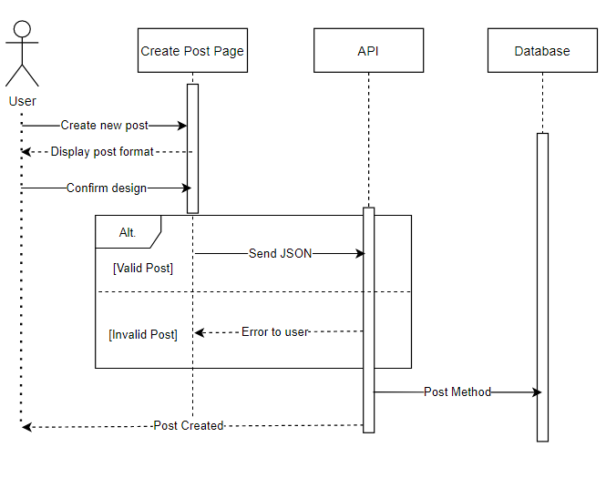
Create Announcement

Slide 7
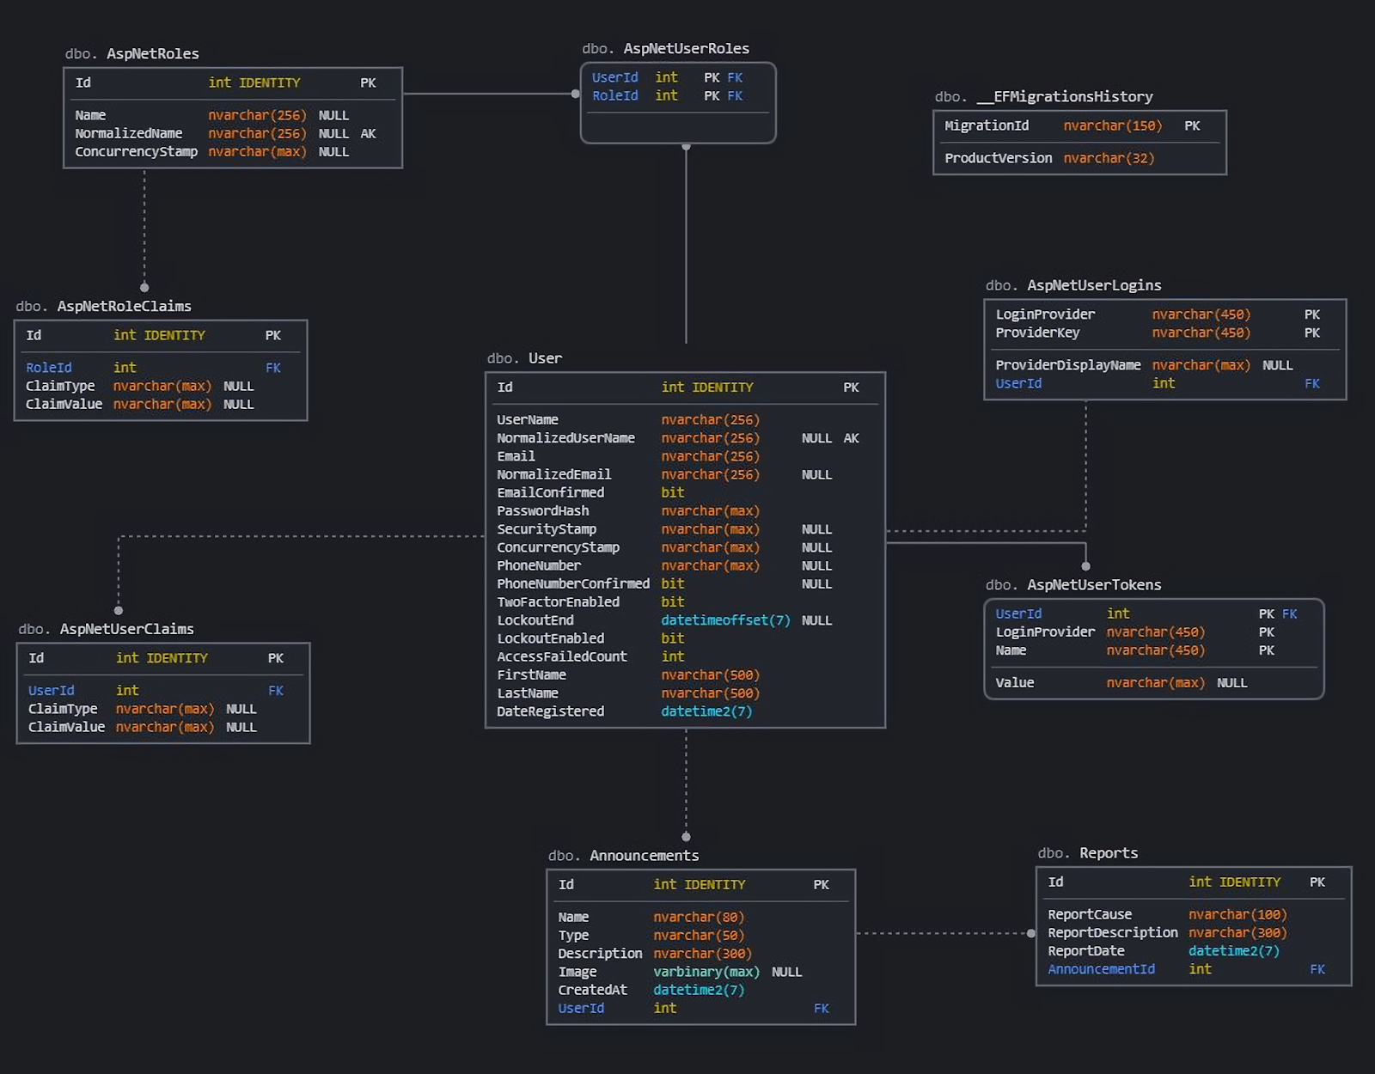
Entity Relationship Diagram

Slide 8
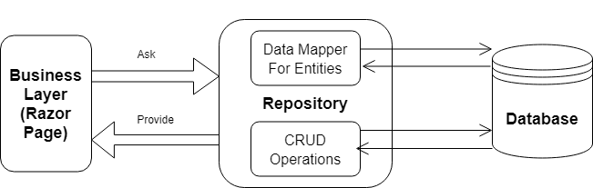
Repository Design Pattern

Slide 9
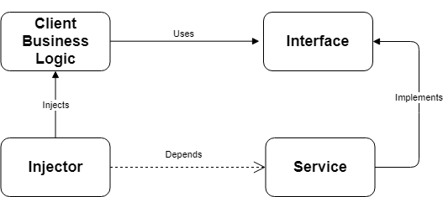
Dependency Injection Design Pattern

Slide 10
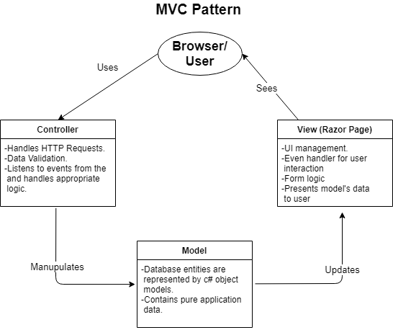
Architecture Diagram
MVC Design Pattern

Slide 11
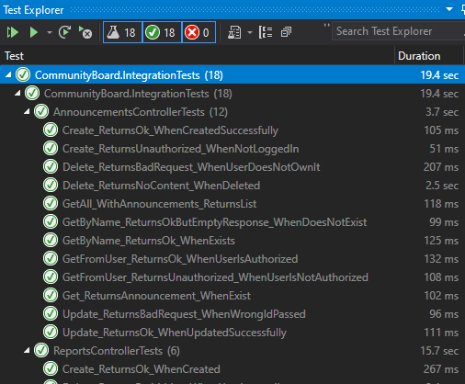
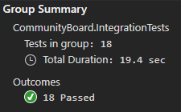
Integration Testing

Slide 12
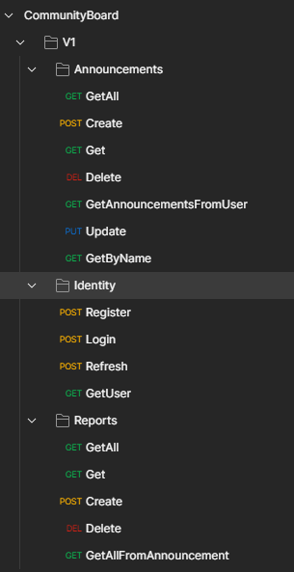
API Endpoints

Slide 13
User Test Cases
Over 40 test cases were made such as:
User Registration.
User Login and Password Validation.
Announcement Creation, Updating & Validation.
Contact Page and Email Functions.
Report Announcement Page.

Slide 14
Potential Enhancements
Chat embedded on the website.
Report management page in website (this is available in the API, but not on the website itself).
Announcement log storage.
Better work on the front end, making it look prettier.
Better security to prevent CSRF attacks (usage of refresh tokens).
More search options when searching for an announcement.
User account management page. Let them change their name, password, email, username, etc.
Add options to sign in with social media or other services (like GitHub).
Admin pages to manage users (for example: being able to ban a user).
API Pagination, filtering, validation.

Slide 15



Lessons Learned
Communication is important and could have gone better.
Time management is key, balancing time between other classes/courses.
We could’ve had more meetings than we did.

Slide 16

THANK YOU!!
Let’s go live now!!

